Slide 1
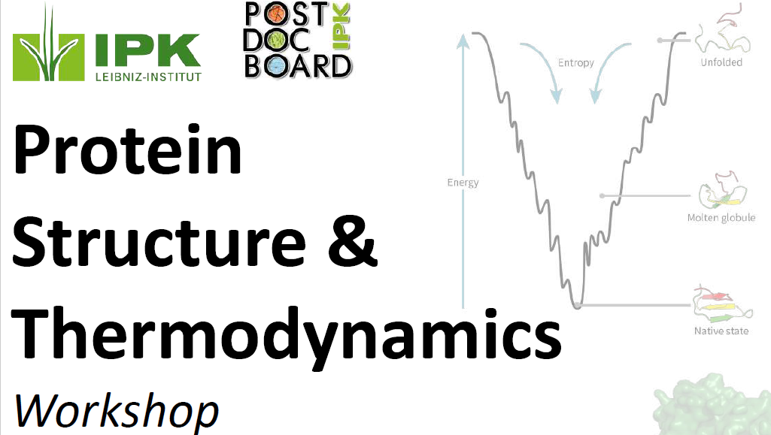
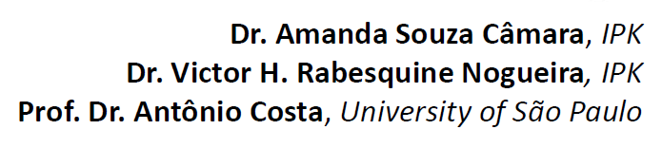

Slide 2


Protein Structure – An Overview
Antonio Costa
Physics Deparment
Ribeirão Preto Faculty of Philosophy, Sciences, and Letters
University of São Paulo

Slide 3
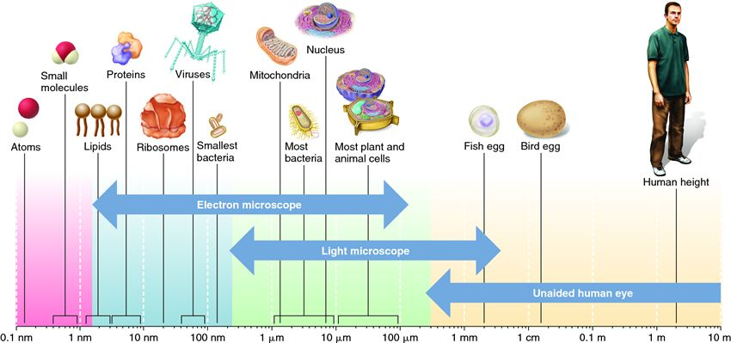
Organization of Biological Systems
Nanoscale
Mesoscale
Macro
https://biology-forums.com/index.php?action=gallery;sa=view;id=215

Slide 4
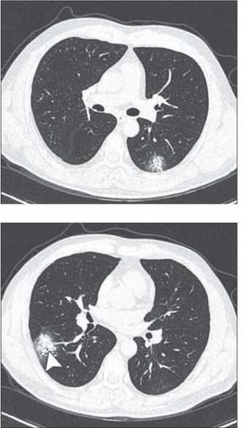
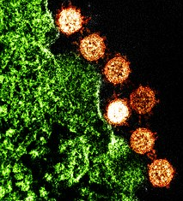
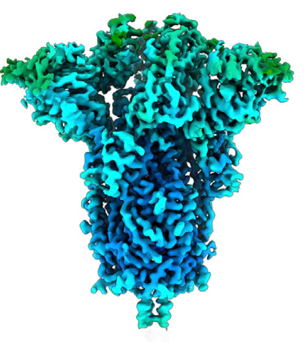
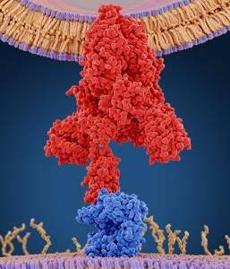
Structural Hierarchy
Physiology
Bio Cell
Molecular Biophysics/Biochemistry
Revista FAPESP, Abril (2020)
Site American Society for Microbiology (2020)
https://theconversation.com/ace2-the-molecule-that-helps-coronavirus-invade-your-cells-138369
Walls. et al. Cell 180, 281(2020)

Slide 5
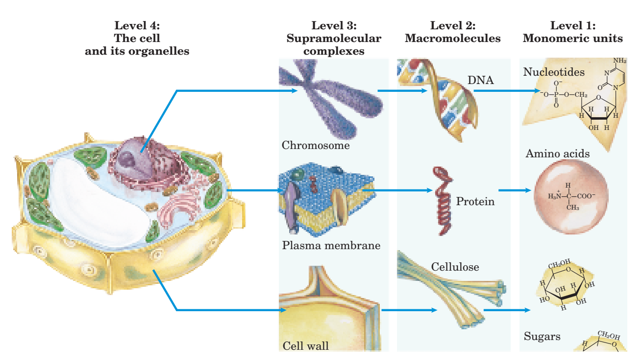
Structural Hierarchy
Lehninger’s Principles of Biochemistry, Chap 1, p. 11

Slide 6
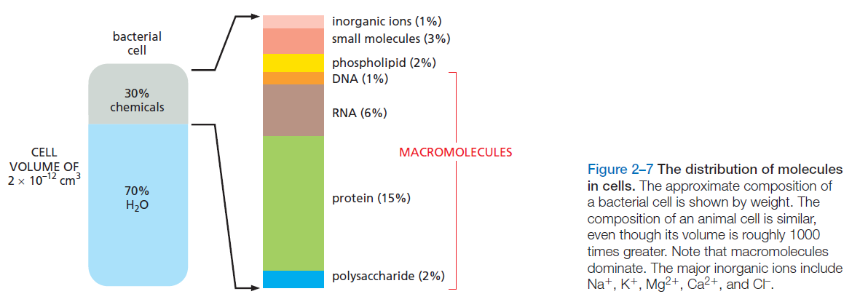
Molecules in the cell
Bruce Alberts, The Cell, 7th edition, chap. 2, p. 55

Slide 7
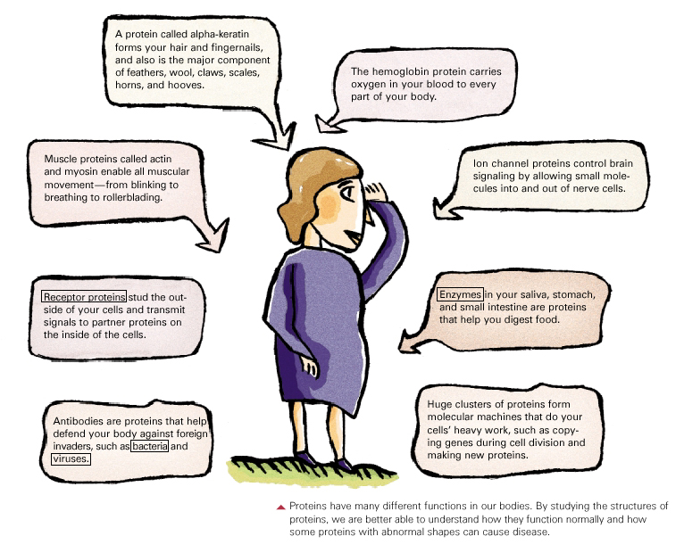
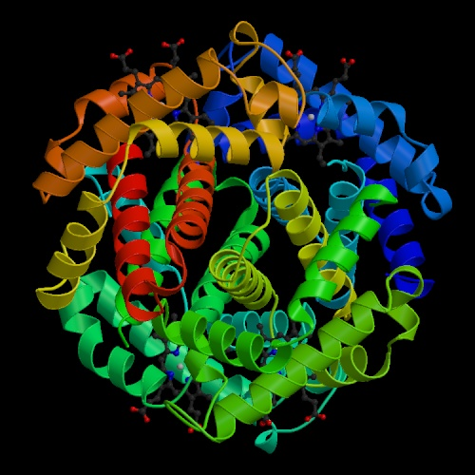
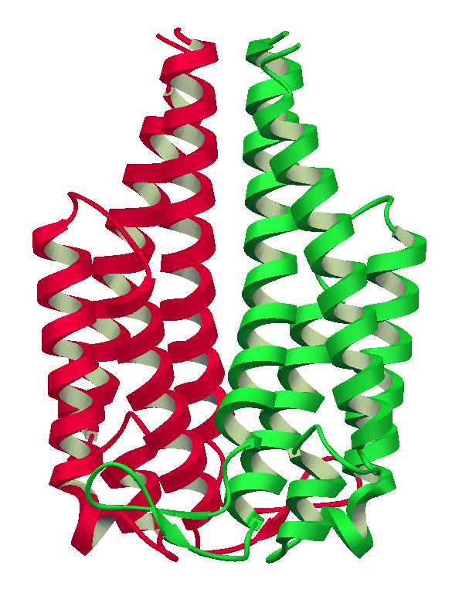
PROTEÍNAS

Slide 8
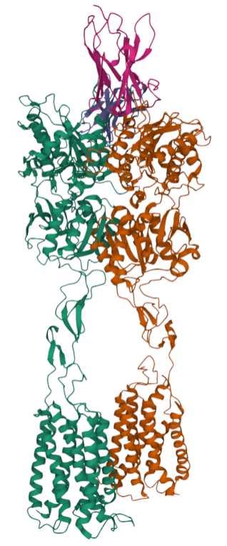
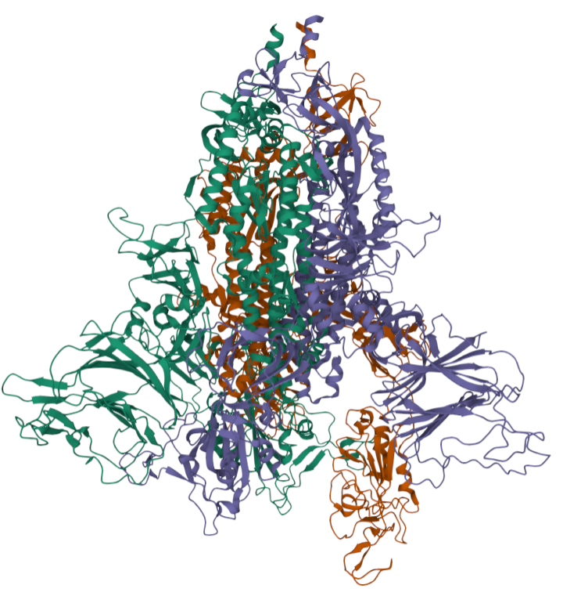
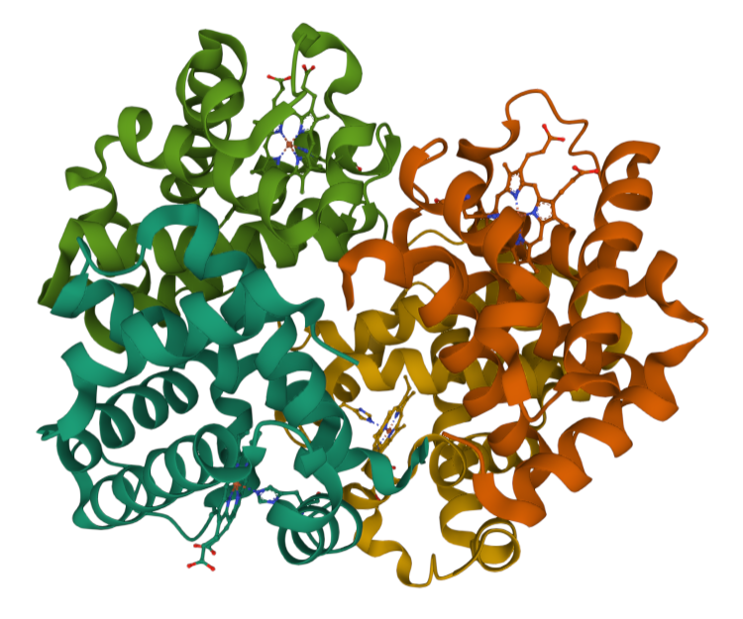
A “zoo” of structures – Structural Biology
Protein Data Banck (PDB) - https://www.rcsb.org/
PDB: 7DGE
PDB: 7DZW
PDB: 1HV4

Slide 9
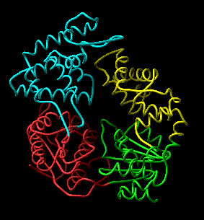
Not only the structure

Slide 10
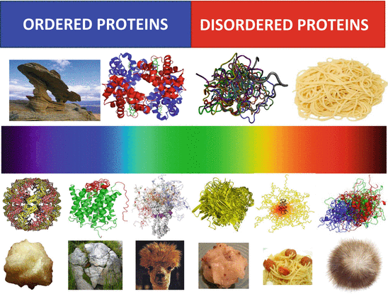
Structural and Unstructural Biology
DisProt - https://www.disprot.org/
Uversky, Molecular Science of Fluctuations Toward Biological Functions pp 125-150

Slide 11
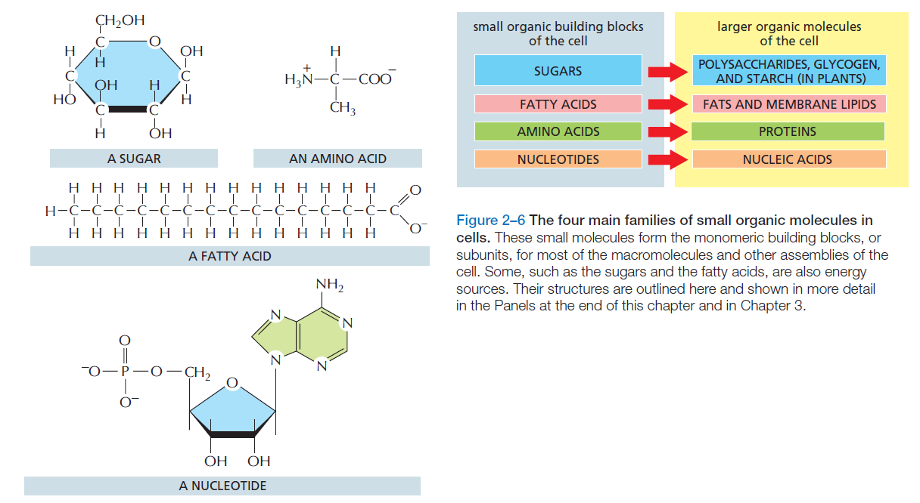
Structural Hierarchy – The Building blocks
Bruce Alberts, The Cell, 7th edition, chap. 2, p. 54

Slide 12
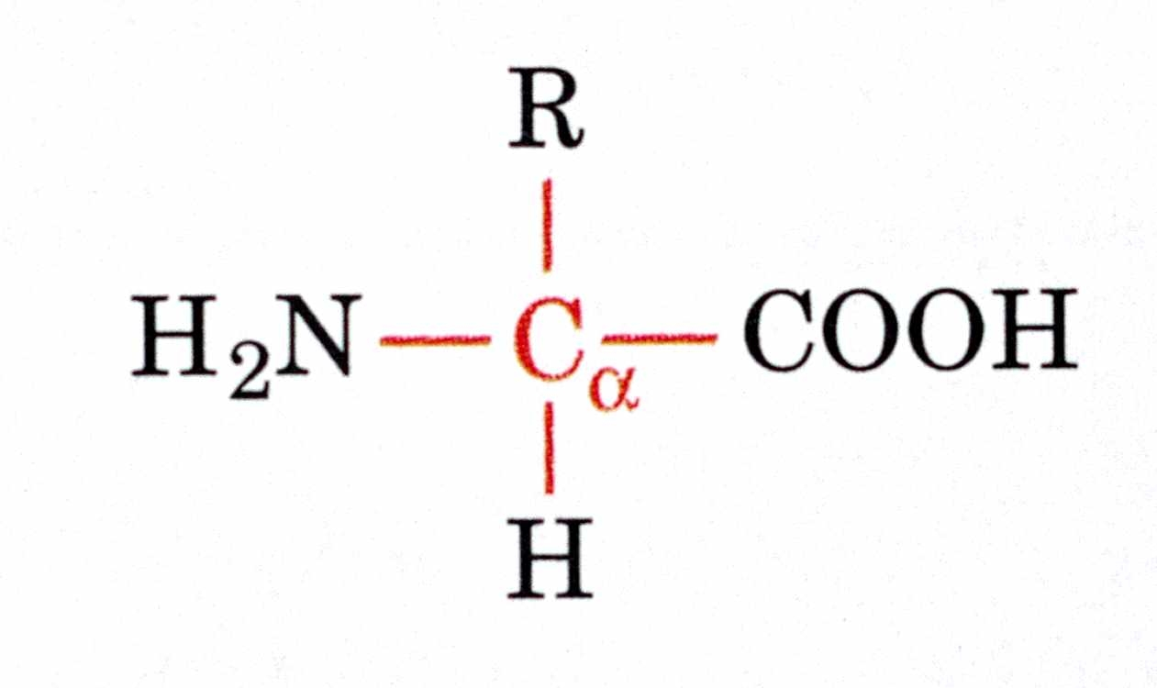
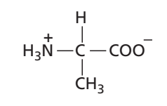
Aminoacids

Slide 13
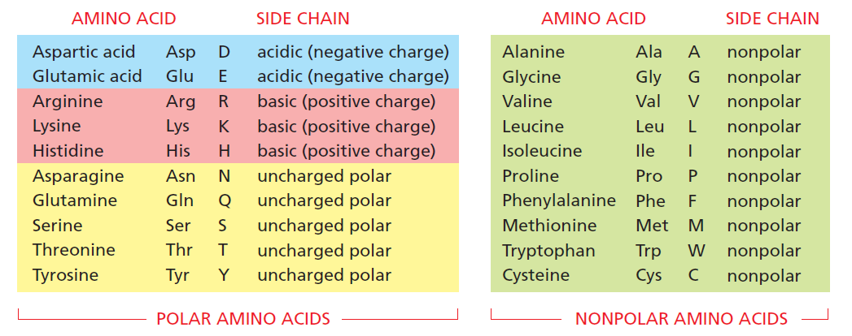
Aminoacids
Bruce Alberts, The Cell, 7th edition, chap. 3, p. 116

Slide 14
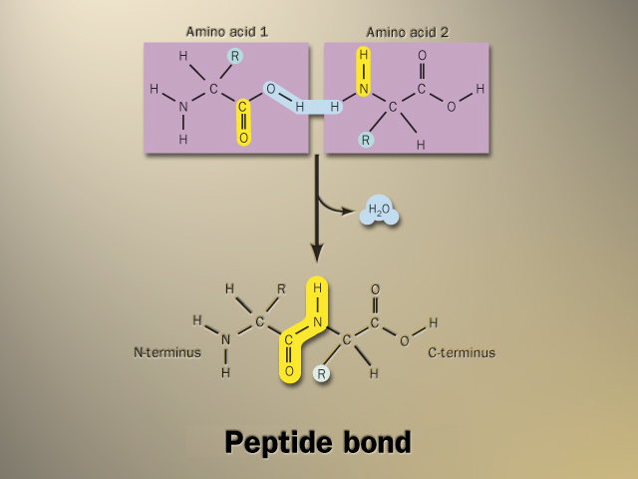
Peptide Bond – Formation

Slide 15
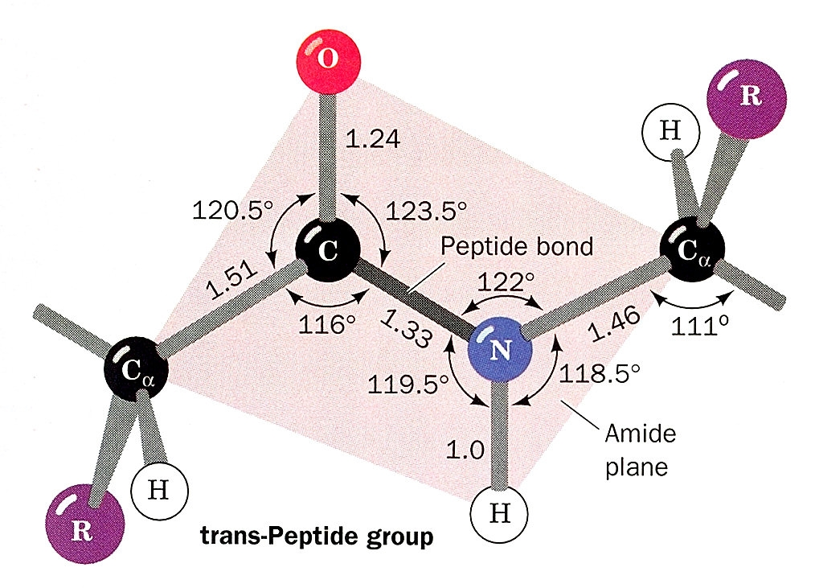
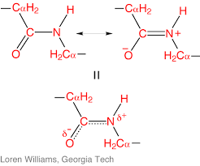
Peptide Bond – Geometry
Double-bond character: rigid and planar

Slide 16
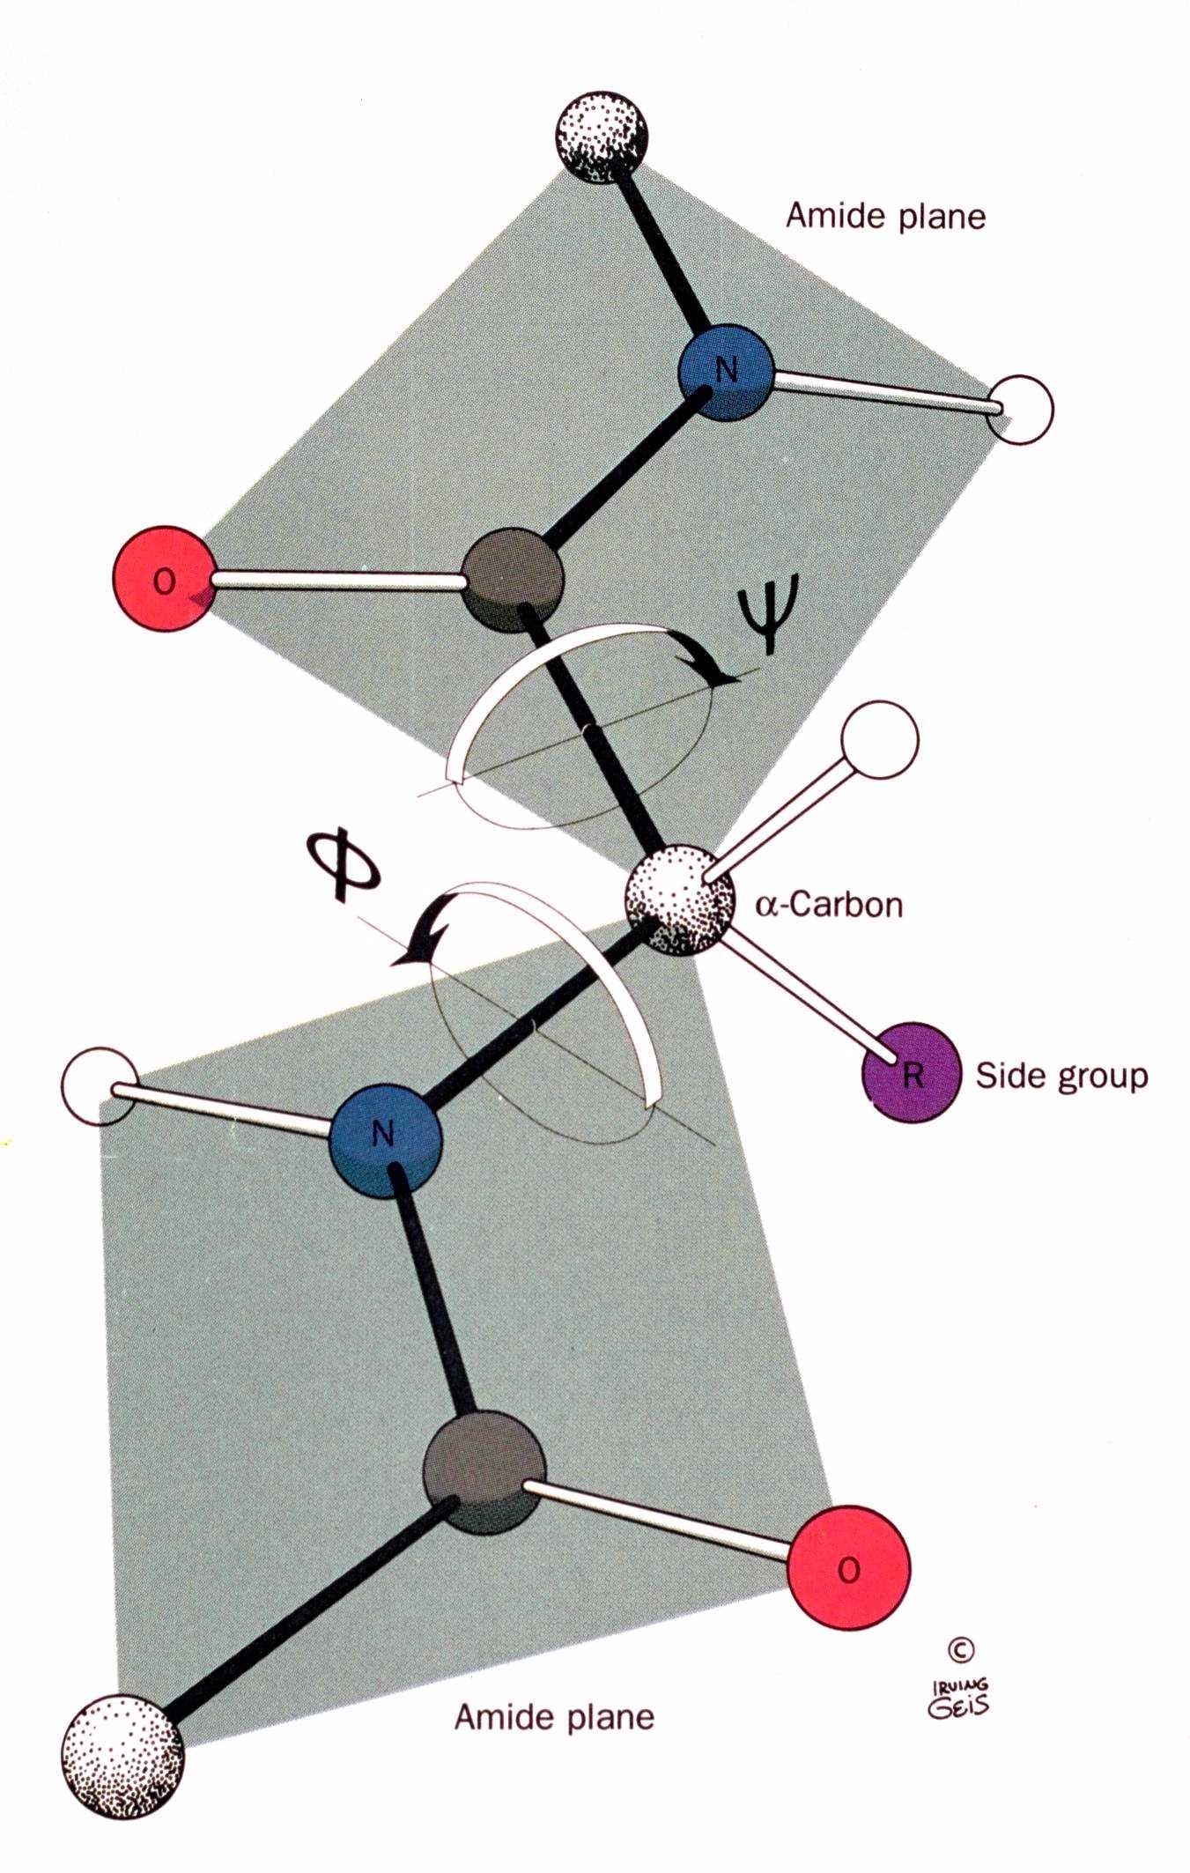
Peptide Bond – Torsion angles
Cantor & Schimell, Chap. 5, vol I

Slide 17
Primary Structure
N
C
amino-terminal
carboxi-terminal

Slide 18
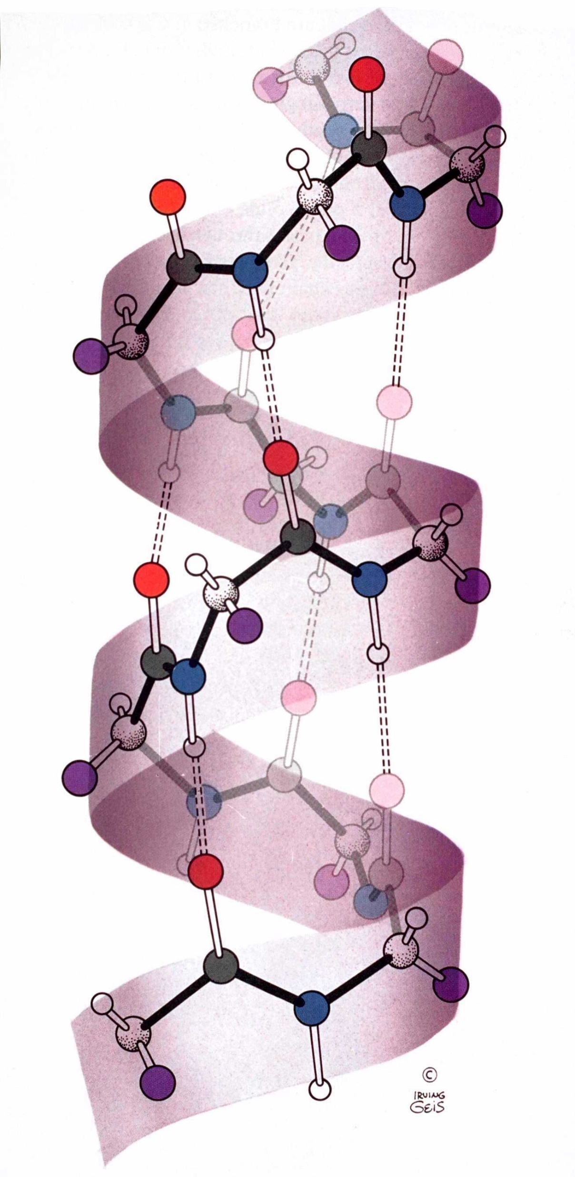
Secondary Structure
α-helix
More common form
= - 57º e ψ=- 47º
Residues per turn = 3.6
Stabilized by hydrogen bonds between NH and CO groups of the main chain
CO interacts with NH 4 residues ahead in sequence
Side chains point outwards
Dipole moment align along the helix axis (more on this to come!)

Slide 19
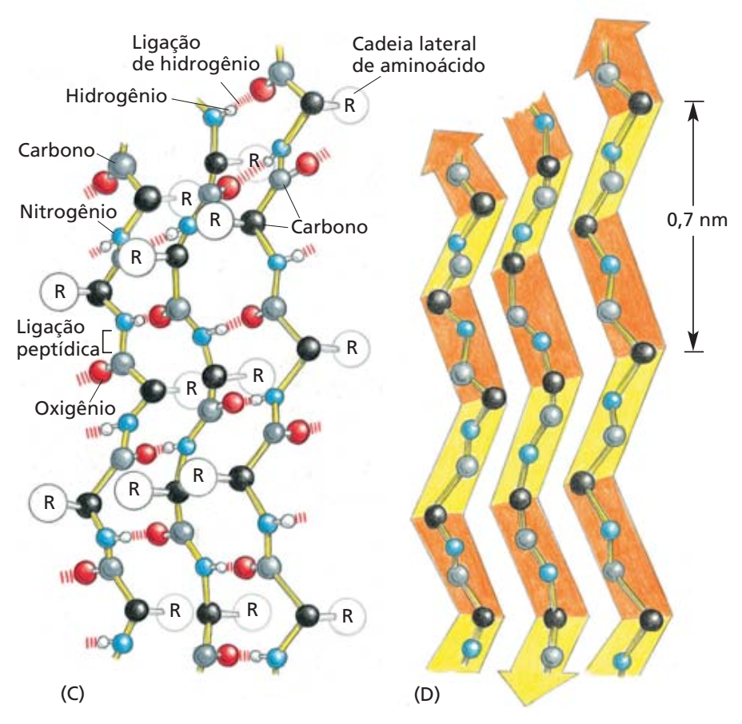
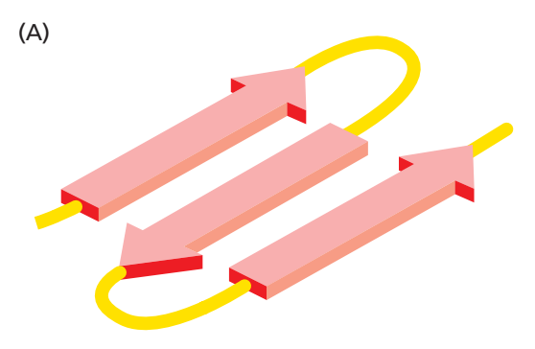
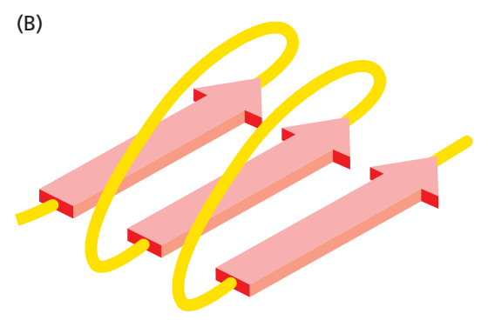
Secondary Structure
β sheet
β sheets are composed of strains
Stabilized by hydrogen bonds between NH and CO groups from different strains

Slide 20
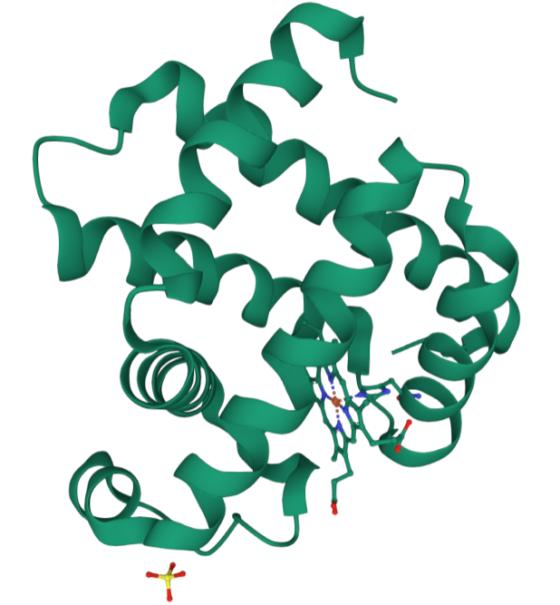
Tertiary Structure
https://www.rcsb.org/3d-view/1WLA/1
Myoglobin

Slide 21
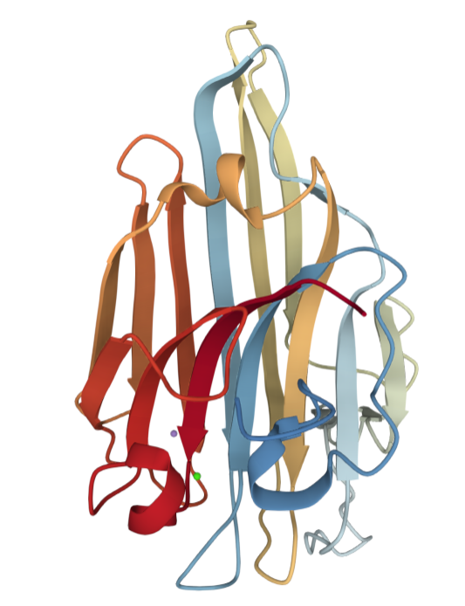
Tertiary Structure
https://www.rcsb.org/3d-view/5YGM/1
Concanavalin

Slide 22
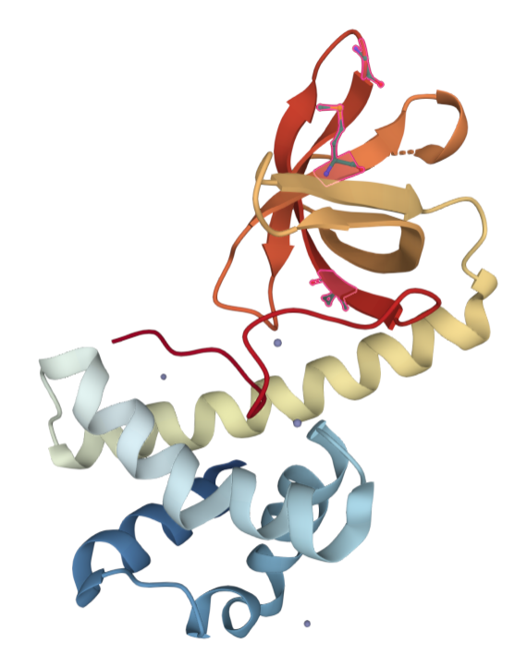
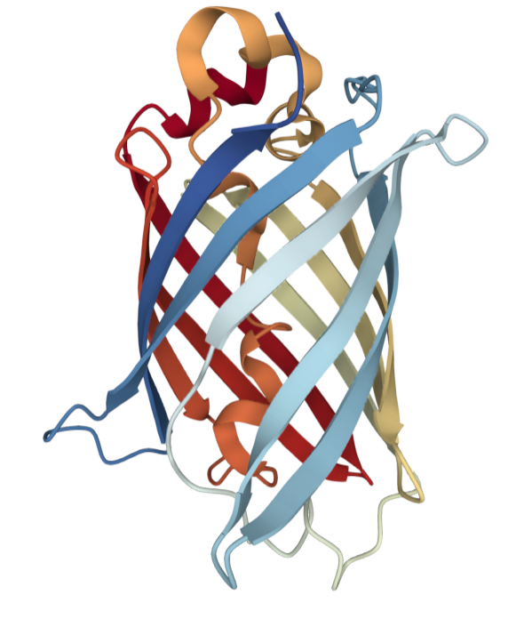
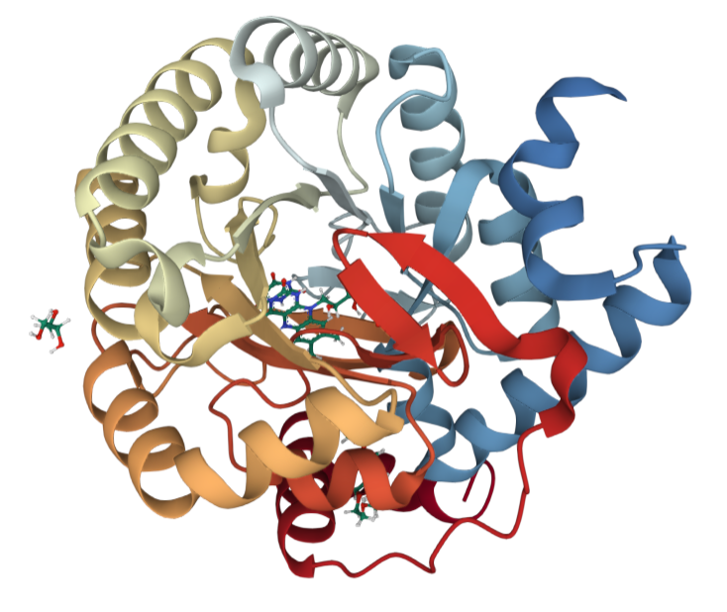
Tertiary Structure
PDB: 1KL9
PDB: 4OGS
PDB: 5K9D

Slide 23
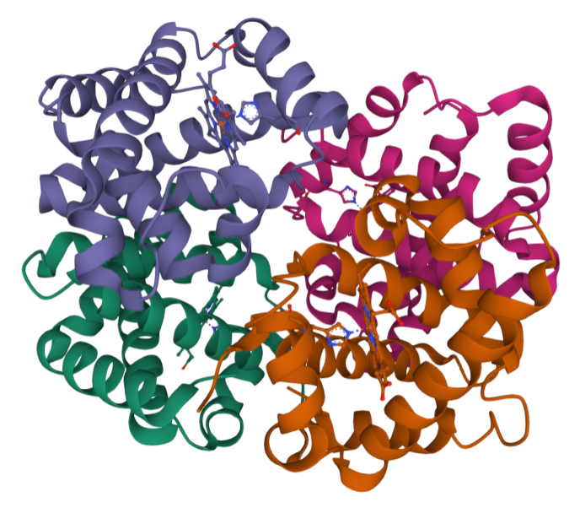
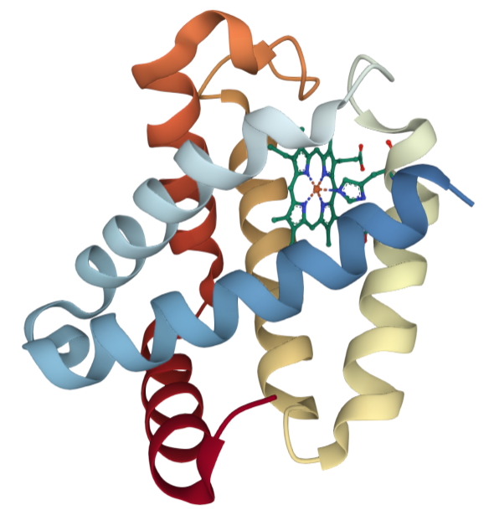
Quaternary Structure
PDB: 1SI4
PDB: 1JF3
Giant Hemoglobin - https://www.rcsb.org/3d-view/7E97/1

Slide 24
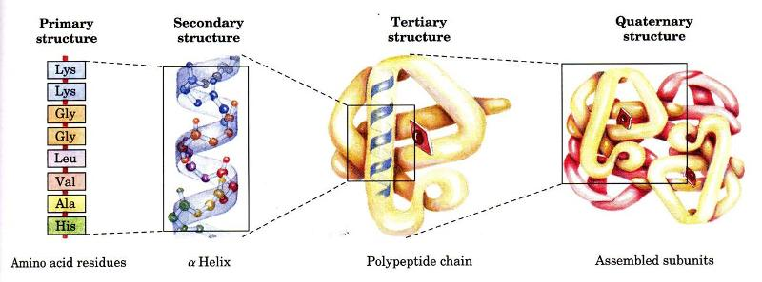
Another structural hierarchy

Slide 25
How to form and stabilize such structures?

